Slide 1
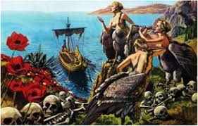
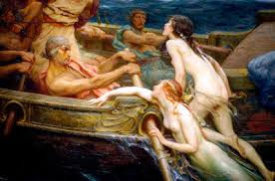
Sirens Kyriakos Ioannou Year 6(2)

Slide 2
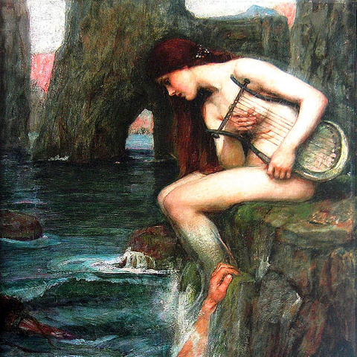
Sirens were female creatures who were related to water, love, and death.

Slide 3
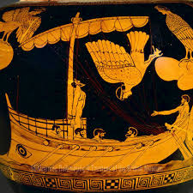
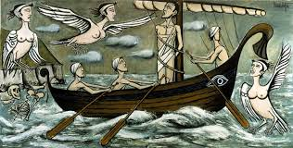
They were considered as marine demons in Greek Mythology with half a woman’s and half a predatory bird’s body.

Slide 4
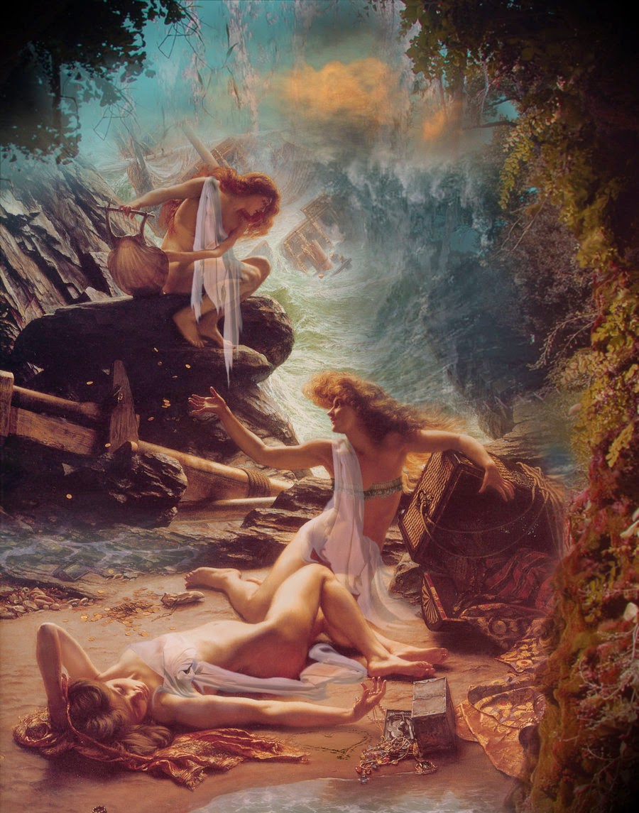
Because of their beauty and their amazing voice, they enchanted the sailors and led them to a horrible death.

