Slide 1
My favourite sport.
Basketball

Slide 2
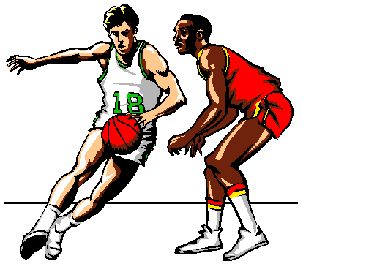
Rules of the game.
Basketball is a team sport. Two teams of five players each try to score by shooting a ball through a hoop elevated 10 feet above the ground. The game is played on a rectangular floor called the court, and there is a hoop at each end. The court is divided into two main sections by the mid-court line. If the offensive team puts the ball into play behind the mid-court line, it has ten seconds to get the ball over the mid-court line. If it doesn't, then the defense gets the ball. Once the offensive team gets the ball over the mid-court line, it can no longer have possession of the ball in the area in back of the line. If it does, the defense is awarded the ball.

Slide 3
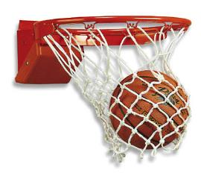
The End

