Slide 1
CENTAURS

Slide 2
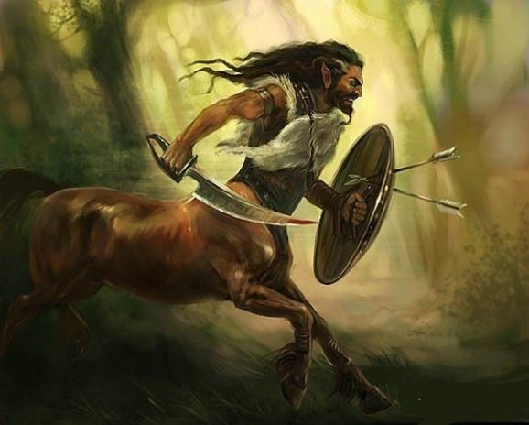
CENTAUR WAS A CREATURE FROM GREEK MYTHOLOGY.
HIS UPPER BODY WAS A MAN AND HIS LOWER BODY WAS A HORSE.

Slide 3
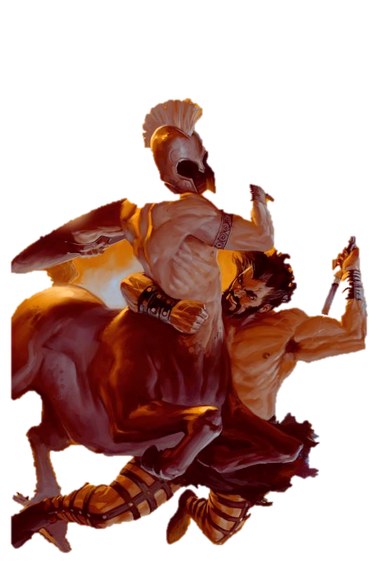
CENTAUR vs HERCULES

Slide 4
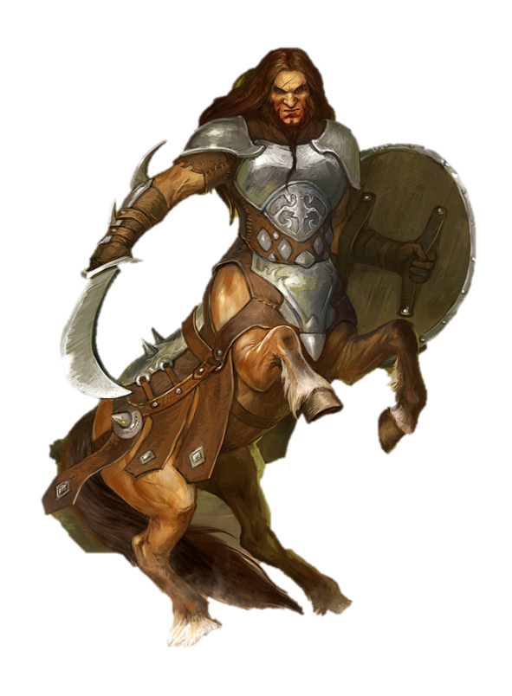
THE END
RAPHAEL MARCOU

