Slide 1
THE MINOTAUR
GREEK MΥTHOLOGY

Slide 2
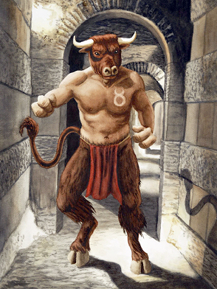
THE MINOTAUR IN THE LABYRINTH

Slide 3
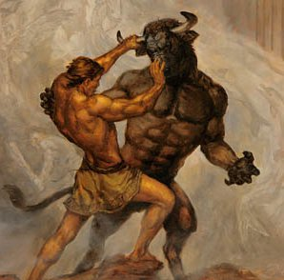
THE MINOTAUR WAS A CREATURE WITH THE HEAD AND THE TAIL OF A BULL AND THE BODY OF A MAN. HE WAS LIVING IN THE CENTER OF A LABYRINTH AND HE WAS KILLED BY THESEUS

Slide 4
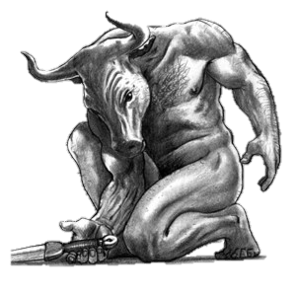
THANKS FOR WATCHING
PRESENTED BY ANDREAS KOUMIS

