Slide 1

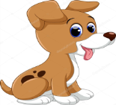
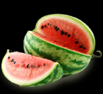







I LIKE
I like karate.
I like dogs.
I like watermelons.
I like ice-creams.
I like food.
Ι like friends.
I like presents.
I like sports.
I like music.
I like school.

Slide 2
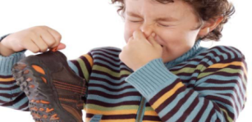
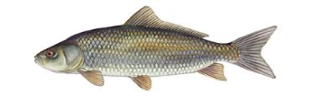


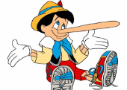

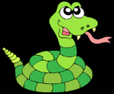
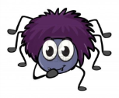
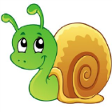

I DON’T LIKE
I hate bad smells.
I hate fish
I hate money
I hate cigarettes.
I hate lies.
Ι hate sickness.
I hate snakes.
I hate spiders.
I hate snails.
I hate bees.
Marinos Mime Year 2

