Slide 1
Medusa
Kyriaki Stavri
Eleftheria Savva
Year 6(1)

Slide 2
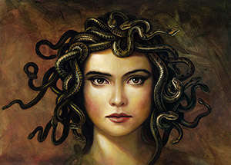
medusa
In Greek mythology Medusa was a monster, a Gorgon, generally described as a winged human female with a hideous face and living venomous snakes in place of hair. Gazers upon her face would turn to stone

Slide 3
Most sources describe her as the daughter of Phorcys and Ceto, though the author Hyginus (Fabulae Preface) makes Medusa the daughter of Gorgon and Ceto. According to Hesiod and Aeschylus, she lived and died on an island named Sarpedon, somewhere near Cisthene.

