Slide 1
CLASS RULES
MARIA SALAMIOTI
Year 6(2)
2017-2018

Slide 2
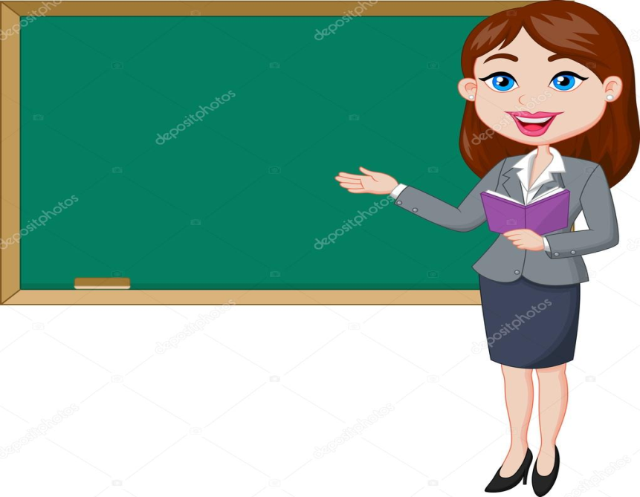
We have many rules in our classroom.

Slide 3
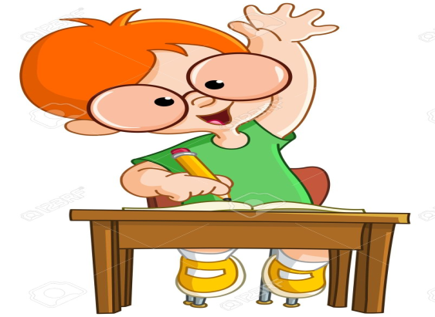
1.WE MUST RAISE OUR HAND IF WE WANT TO SPEAK

Slide 4
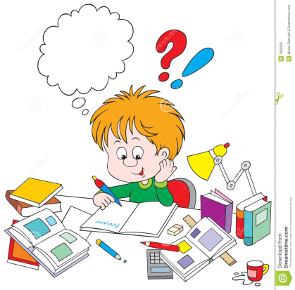
2.WE MUST DO OUR HOMEWORK.

Slide 5
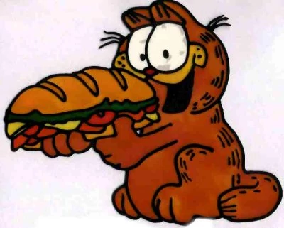
WE MUSTN’T EAT IN THE CLASSROOM

Slide 6
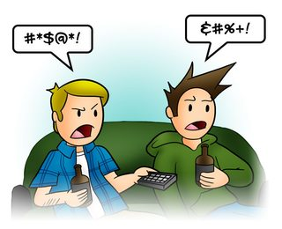
WE MUSTN’T SAY BAD WORDS

Slide 7
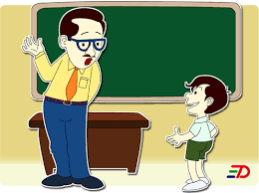
We must be polite to our teachers and classmates

Slide 8
THE END

