Slide 1
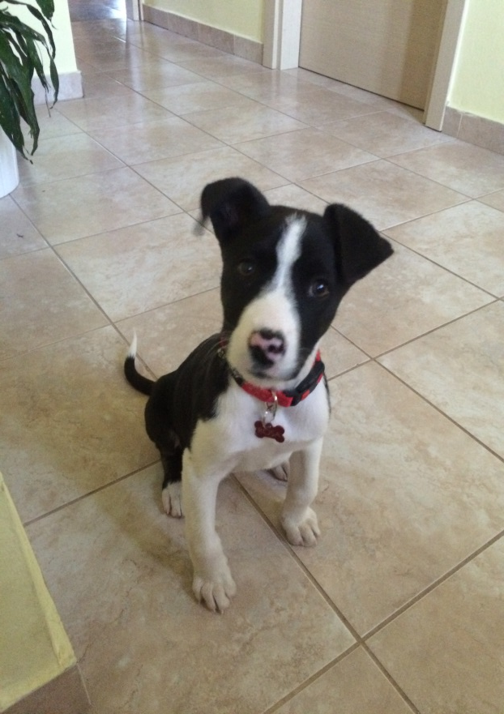
Rosa

Slide 2
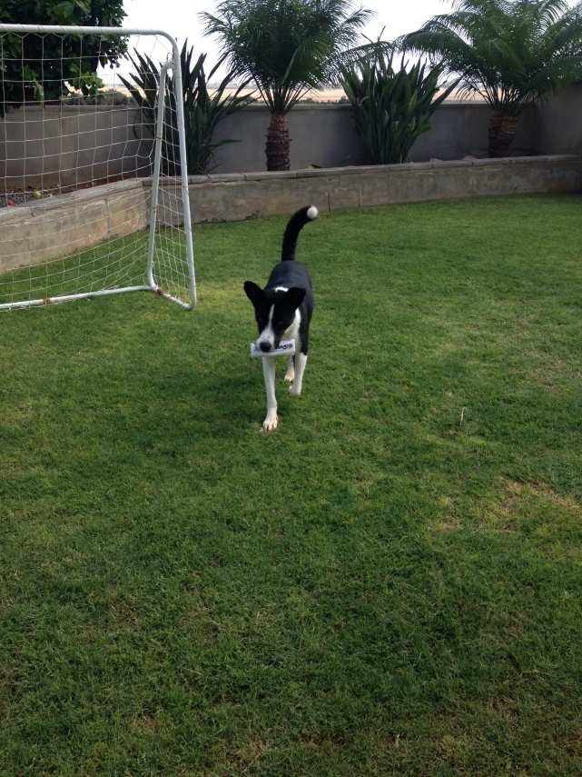
My dog’s name is Rosa.

Slide 3
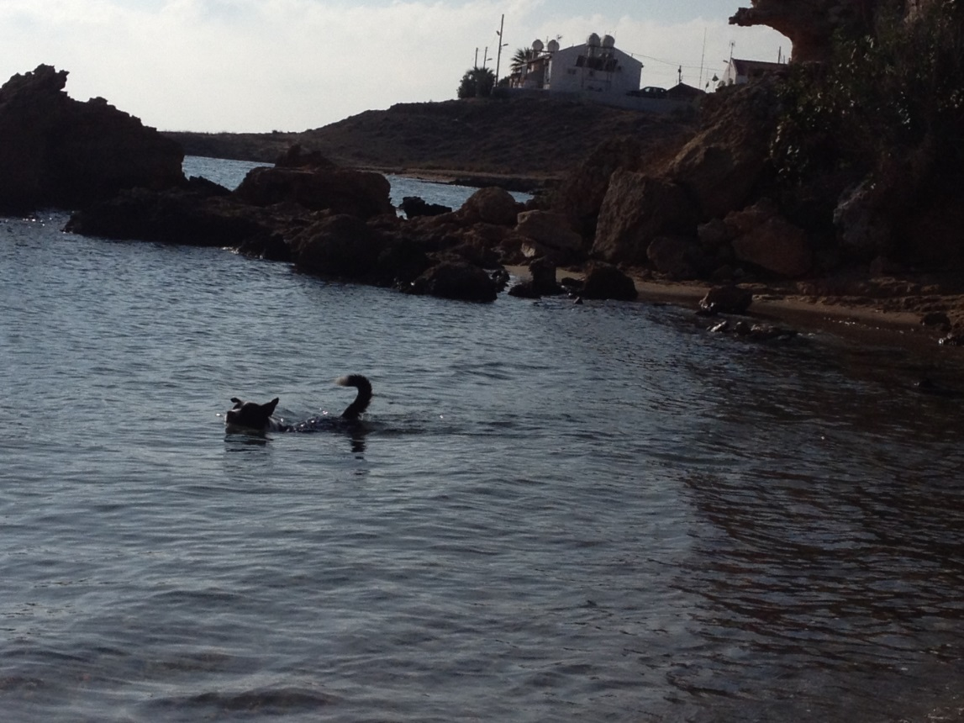
She is black and white.

Slide 4
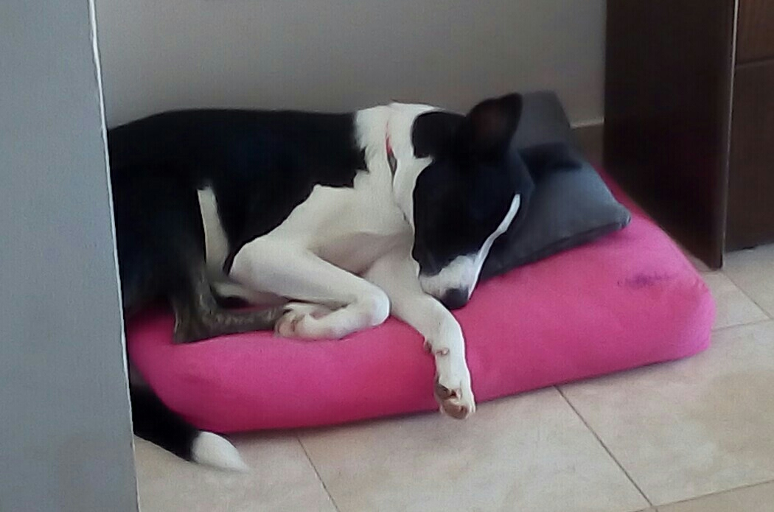
Her favourite food is chicken.

Slide 5
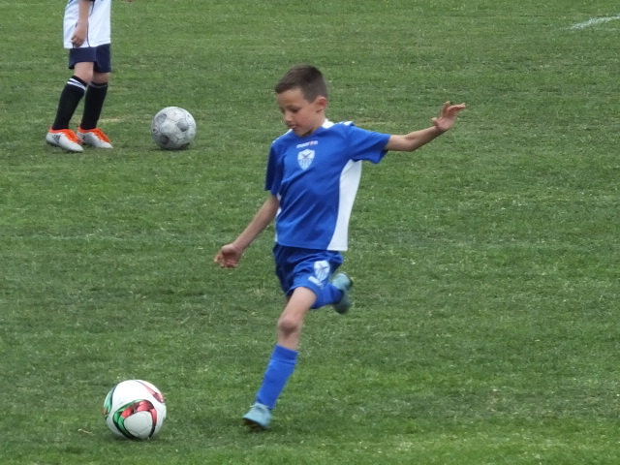
By Lucas Holmshaw Year 3

