Slide 1

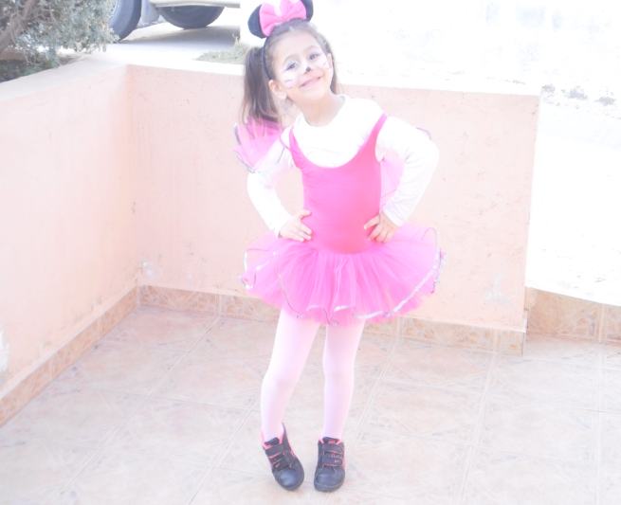
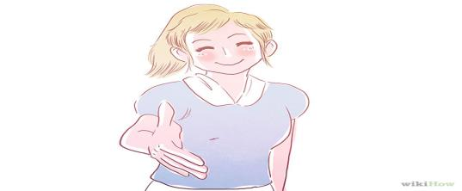


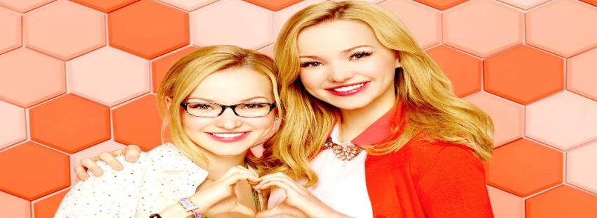

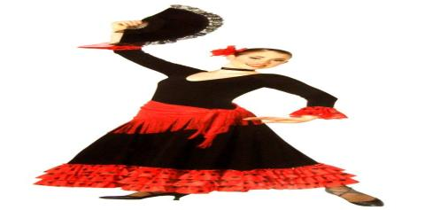
swimming
MYSELF
Maria Salamioti Year6 (2)
NICE
TALL
Beautiful
POLITE
Friendly
dancing
INTERESTING
My favourite TV series is LIV AND MADDIE
DRAMA
I AM A DANCER

