Slide 1
Let’s Start
MY SELF

Slide 2
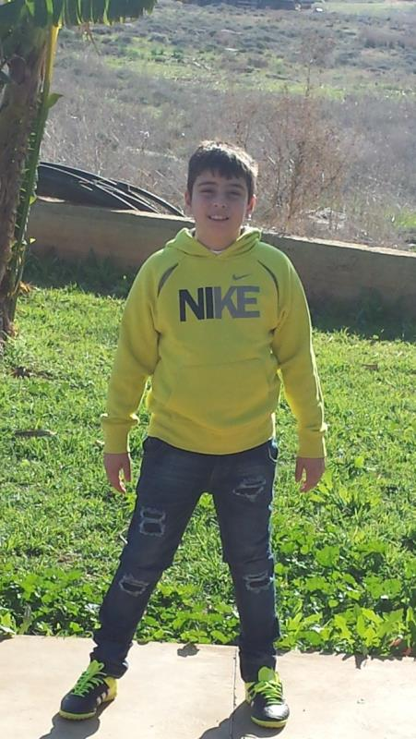
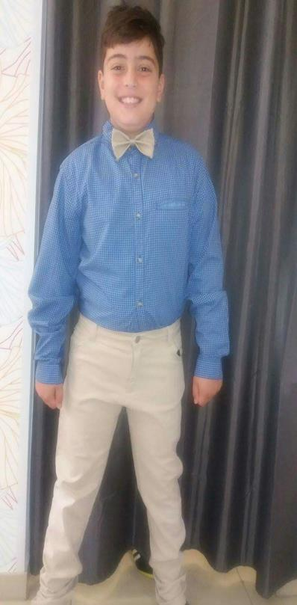
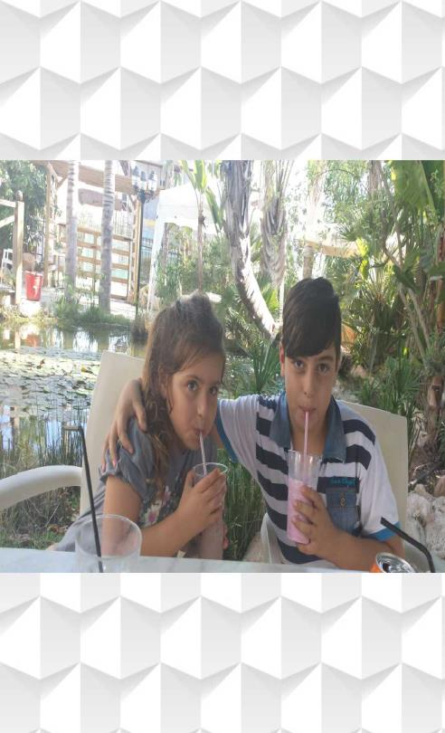
Chris and his sister

Slide 3
Describing my personality
clever
hard working
friendly
noisy
funny
sometimes lazy
polite

Slide 4
All About ME!!!!!
My name is Chris Theori. I am eleven years old. I am very friendly and polite! My school is Sotira A’ Primary school in Sotira and I am in the 6th class. I am really hard working and very clever. Ha , ha !! Really? Really? Sometimes. But I am a really clever boy. I have a dog and her name is Zuke. I have 2 turtles in my room. My favourite day is Saturday because I am playing all day. NO SCHOOL!

Slide 5
My hobbies
CHRIS THEORI
Swimming
Video Games
Playing outside / football / running / riding my bike
Reading a good story
Playing with my dog
Playing with my friends

Slide 6
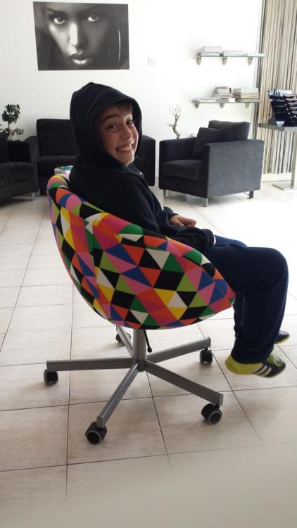
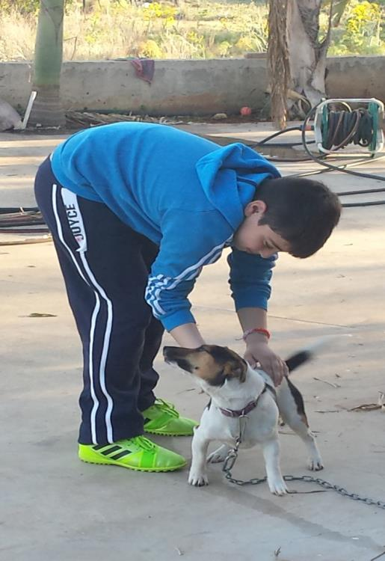
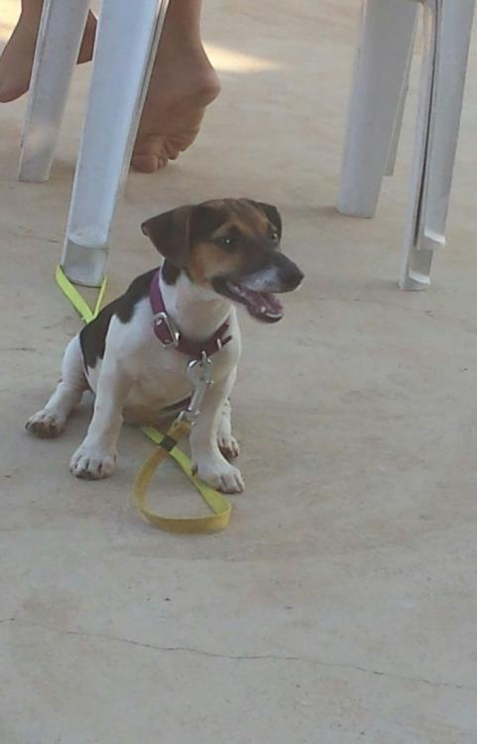
Photos and memories

Slide 7
End of story!!!!!
BYE AND THANKS FOR WATCHING!!

