Slide 1
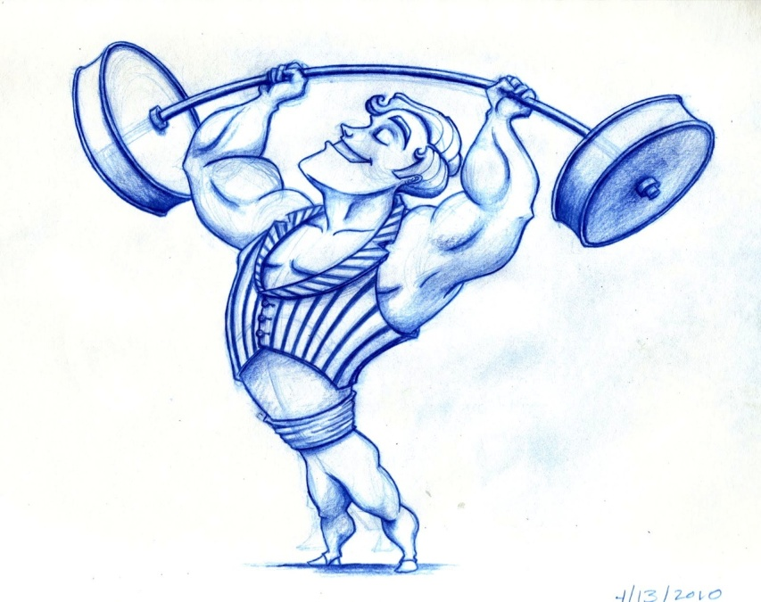
Benefits of exercising Mariam Sozou Year5 (2)

Slide 2
When you exercise you are energetic.

Slide 3
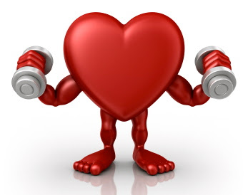
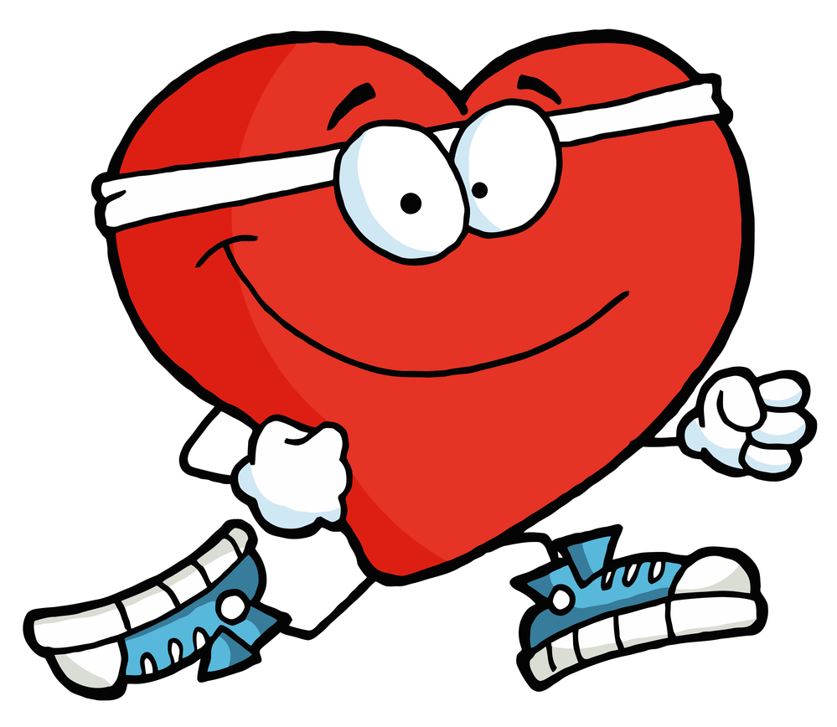
When you exercise you have a healthy heart.

Slide 4
When you exercise you feel good.

Slide 5
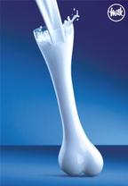
When you exercise you have strong bones.

Slide 6
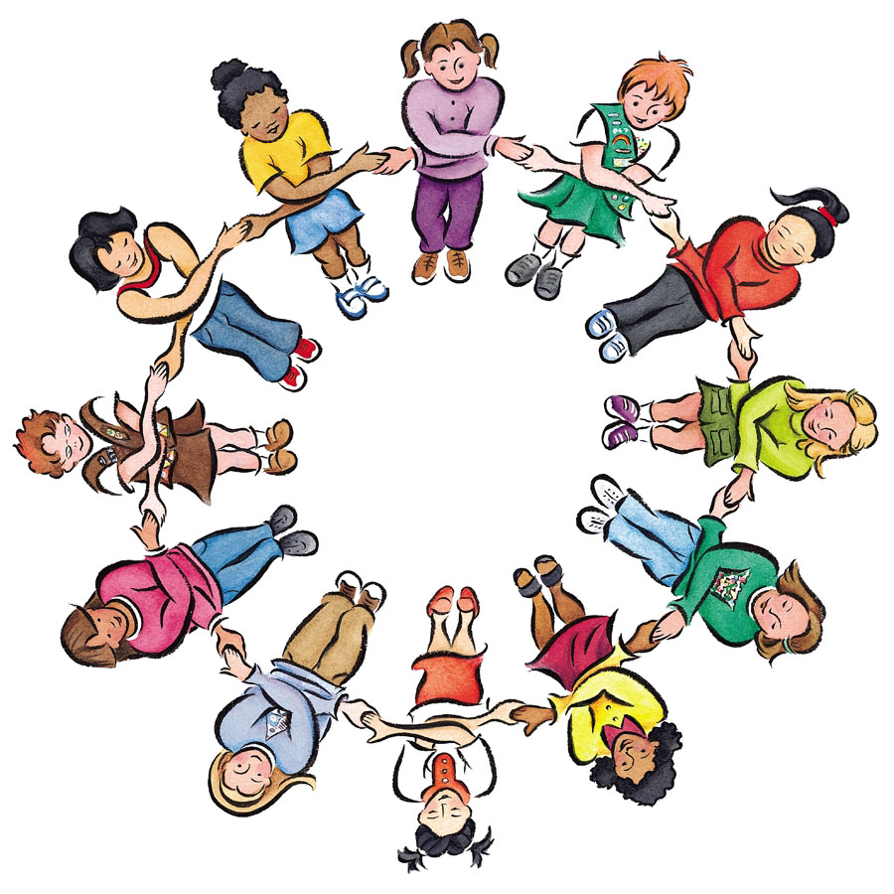
When you exercise you make new friends.

Slide 7
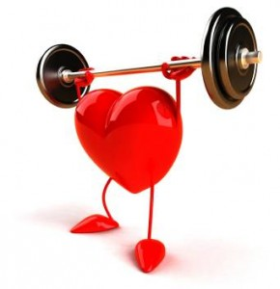
When you exercise you keep fit.

Slide 8
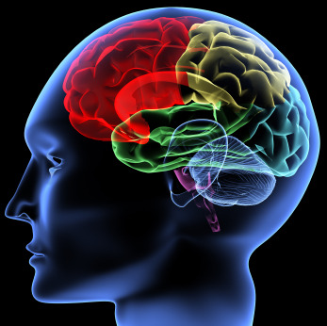
When you exercise you are mentally healthy.

Slide 9
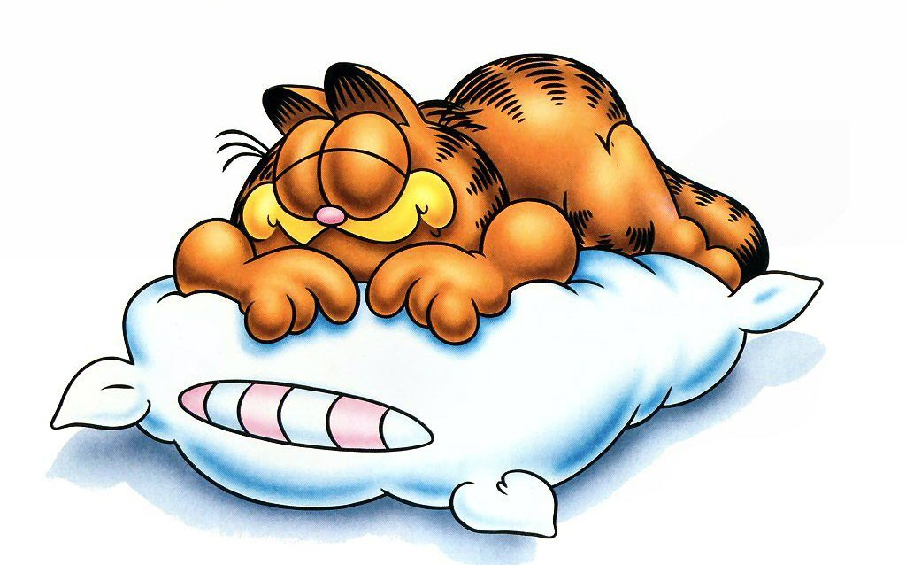
When you exercise you sleep well.

Slide 10
The end

