Slide 1
Mythical Creatures
Kyriaki Andreou
English
Year 6 (1)

Slide 2
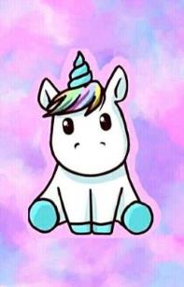
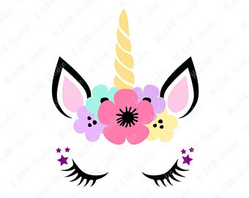
Unicorn
The unicorn is a legendary creature that has been described in antiquity as a beast with a single large pointed, spiralling horn on its forehead.

Slide 3
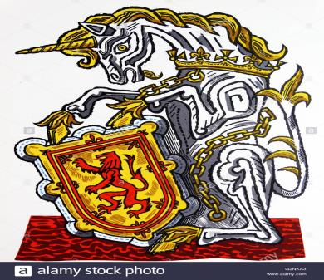
Information
The Unicorn is a horse with a lion’s tail. It’s very strong and has amazing powers. Also, it’s taller than a horse and it has blue eyes. Today it is the symbol of Scotland.

Slide 4
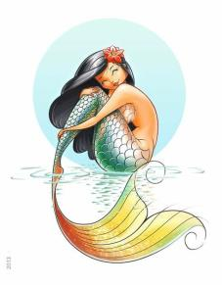
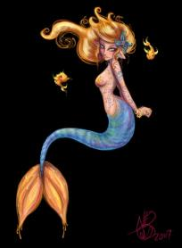
Mermaids
A mermaid is a legendary aquatic creature with the head and upper body of a female human and the tail of a fish.

