Slide 1
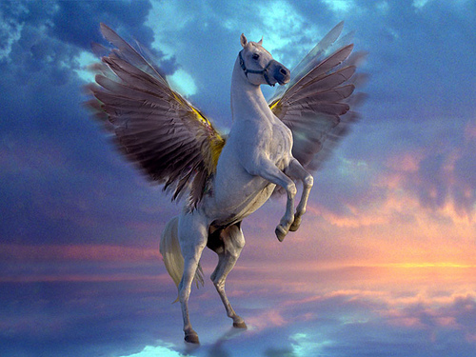
PeGASUS
MARIA SALAMIOTI
6(2)
ENGLISH
2018

Slide 2
WHAT IS PEGASUS
PEGASUS IS A FLYING HORSE IN GREEK MYTHOLOGY.

Slide 3
HISTORY
PEGASUS IS THE SON OF POSEIDON AND THE MEDUSA.
PEGASUS WAS ZEUS’S FAVOURITE HORSE.

Slide 4
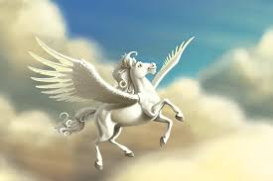
Zeus transformed Pegasus into the eponymous constellation and placed him up in the sky.

Slide 5
VASE WITH A DRAWING OF PEGASUS.

Slide 6
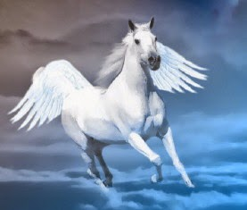
ITS COLOR IS WHITE

Slide 7
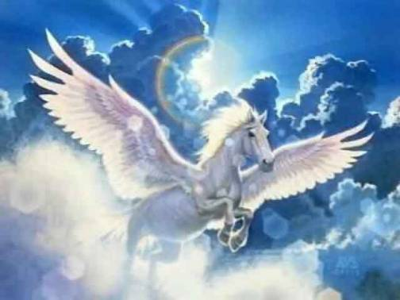
THE END

